Slide 1
Social Media Tourism
Data Science and Business Analytics | Capstone Project
NITYA SINGH

Slide 2
Business Problem and Objective
An aviation company that provides domestic as well as international trips to the customers now wants to apply a targeted approach instead of reaching out to each of the customers. This time they want to do it digitally instead of tele calling. Hence they have collaborated with a social networking platform, so they can learn the digital and social behavior of the customers and provide the digital advertisement on the user page of the targeted customers who have a high propensity to take up the product.
Targeted Digital Advertising: Shift from traditional tele calling to targeted digital advertisements based on customer behavior.
Customer Segmentation: Identify high-propensity customers through data from a social networking platform.
Device-Specific Modeling: Develop separate predictive models for laptop and mobile device users.
Cost-Effective Strategy: Ensure high accuracy in models to optimize advertisement spending

Slide 3
Data Report
The dataset contains 11760 rows and 17 columns
There are 3 float values, 7 integer values and 7 object type values in the dataset
Few columns in the dataset contains null values that needs to be fixed
Few of the columns contain redundant values that need to fixed to create a consistent dataset

Slide 4
Exploratory data analysis
The column ‘UserID’ has been dropped as its not required for the analysis
Column ‘preferred_location_type’ contained two entries ‘Tour Travel’ and ‘Tour and Travel’ which has been fixed to be the same entry as ‘Tour and Travel’
Column ‘Adult_flag’ contained multiple values from 0 to 3. Values greater than 0 were changed to 1
Column ‘yearly_avg_Outstation_checkins’ was categorical type but was changed to numeric type as it contains numerals as data
The dataset also contained null values in few of the columns. NULL values in Numerical Columns were replaced using Median. NULL values in Categorical Columns using Mode

Slide 5
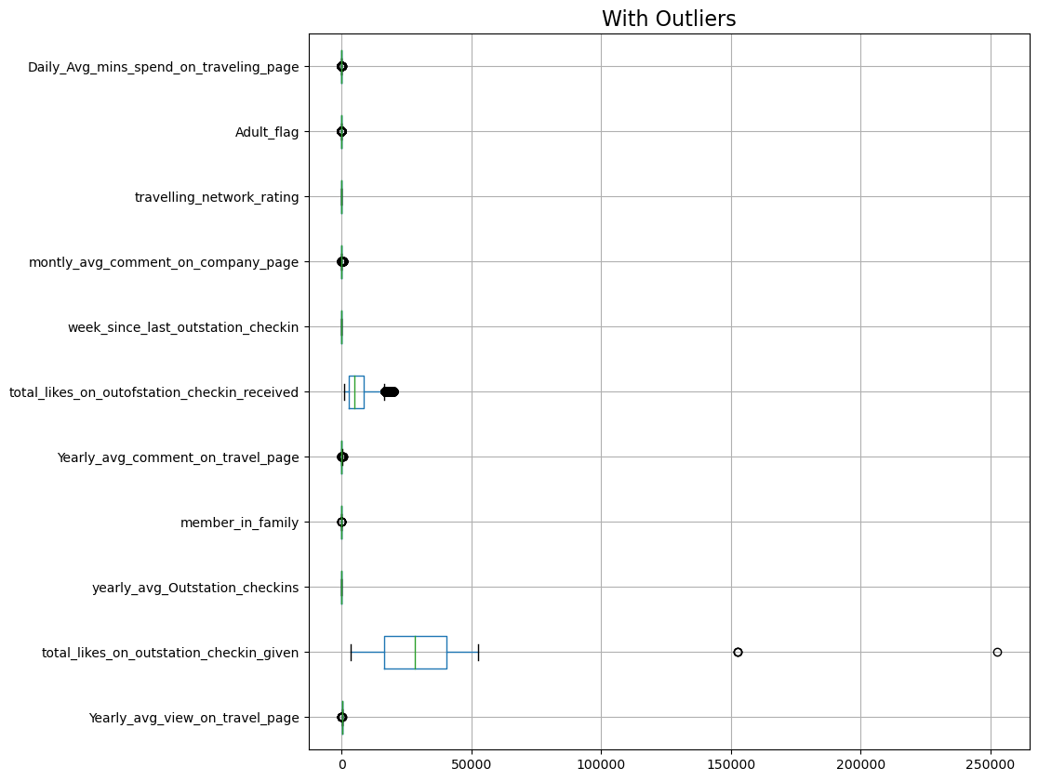
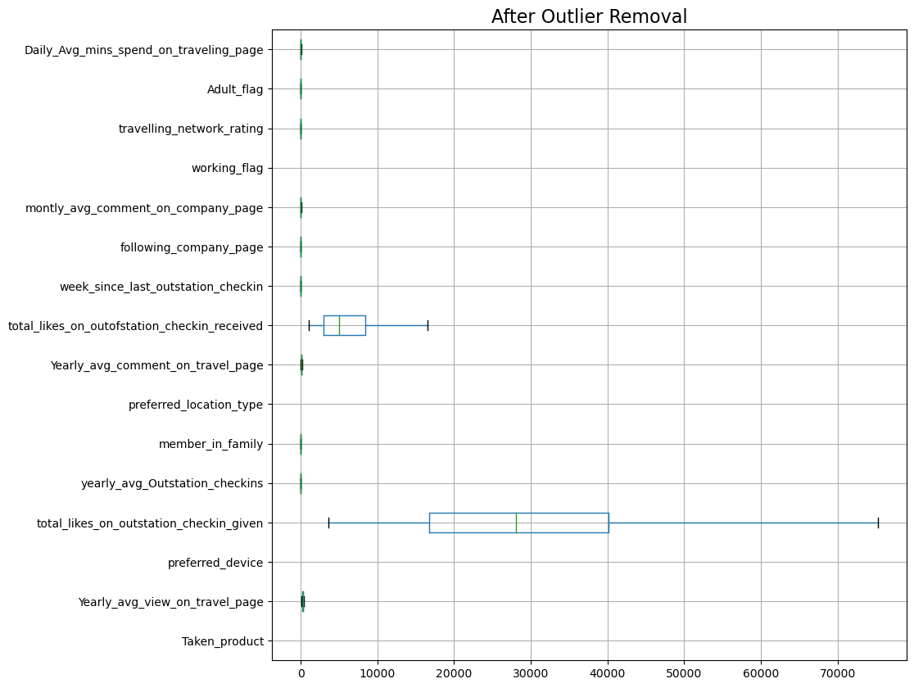
Outliner Treatment

Slide 6
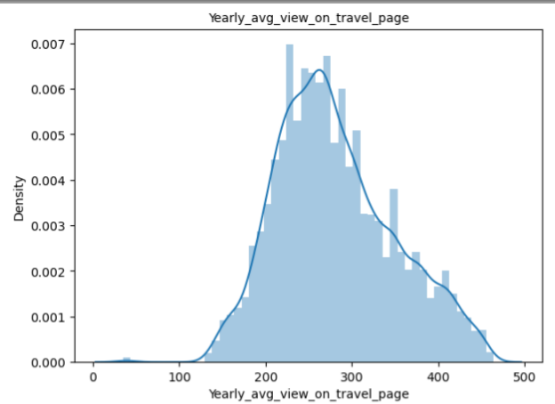
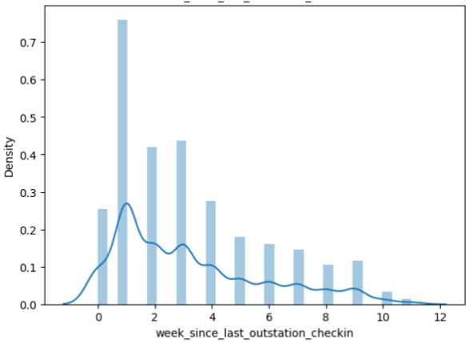
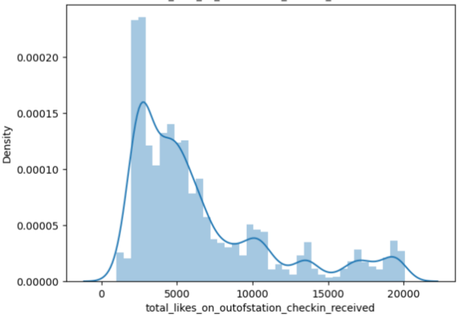
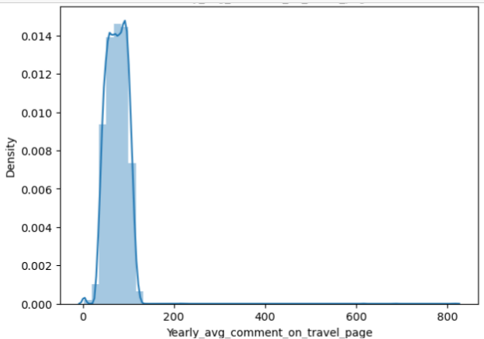
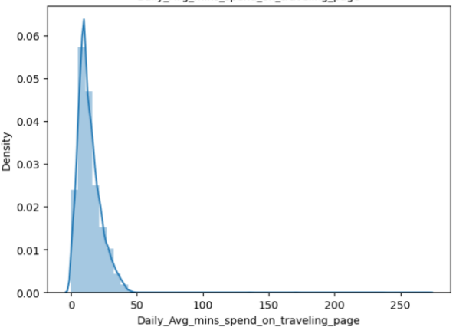
Data Visualisation- Univariant Analysis
Numeric Data:

Slide 7
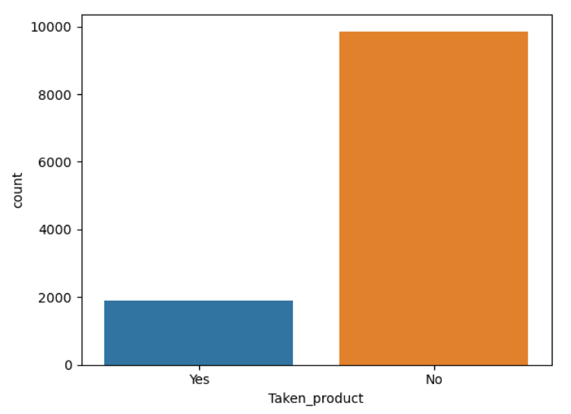
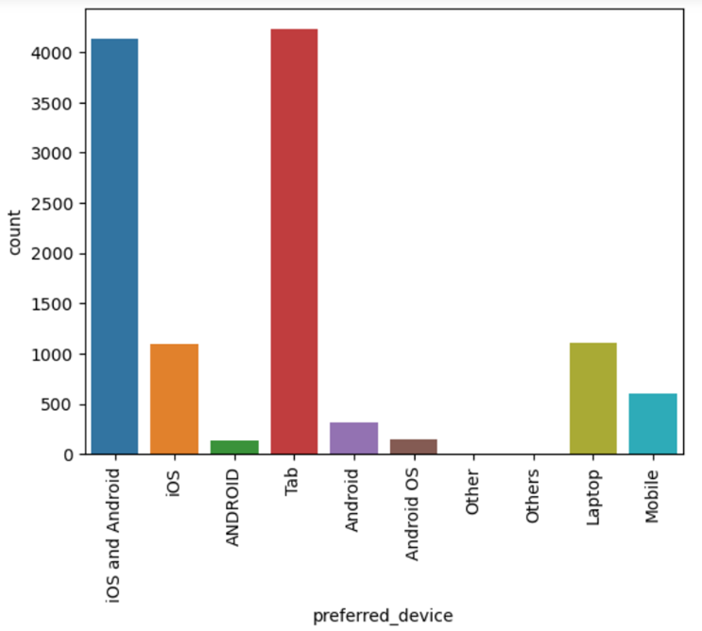
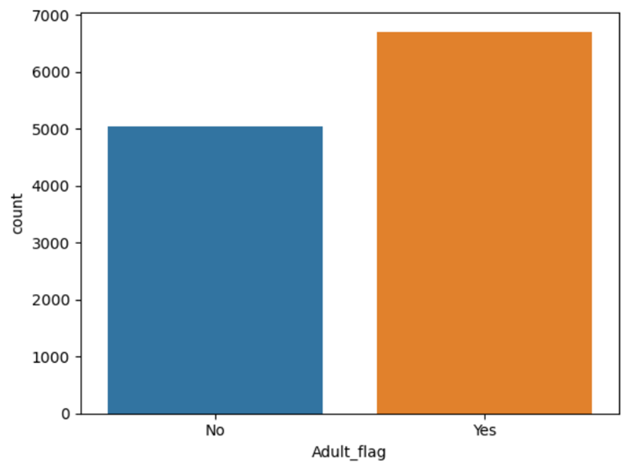
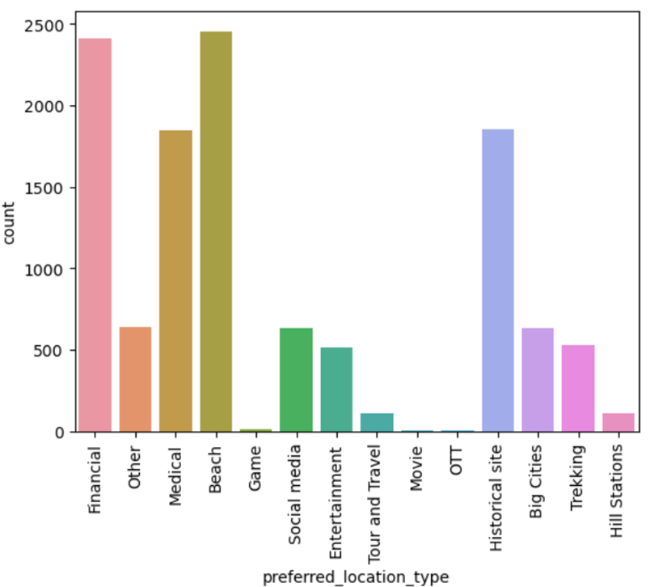
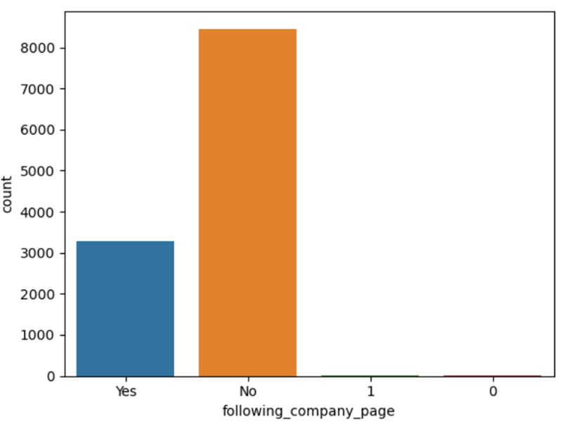
Data Visualisation- Univariant Analysis
Categorical Data:

Slide 8
Model Building
Classification model is used to categorize data into specific classes or groups. The dependent variable is categorical binary.
Models used:
Logistic Regression
Random Forest
K Nearest Neighbours (KNN)
The objective is to predict whether a product will be taken or not. The data is split between Laptop devices and Mobile devices. For model building I have divided the data into a 70:30 ratio. Where, Training data size is 70% and testing data size is 30% of data

Slide 9
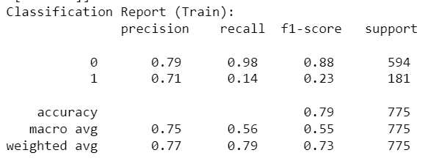
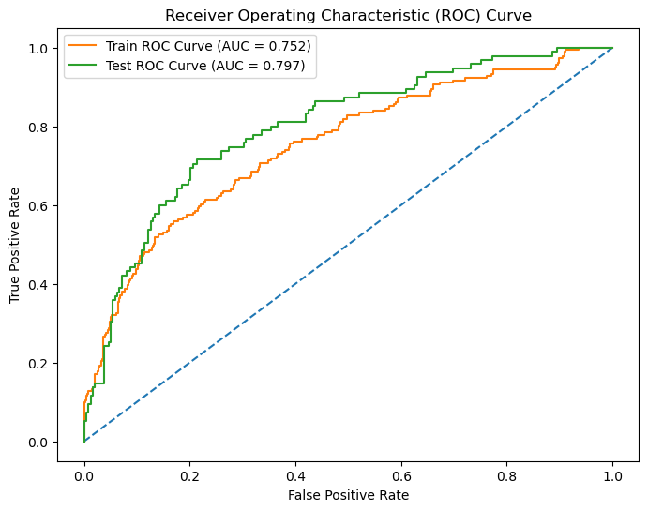
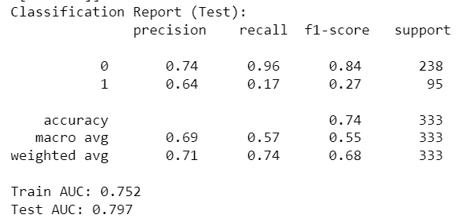
Logistic Regression Model
Laptop Users
Model Performance:
Train Accuracy: 78.58%
Test Accuracy: 73.57%

Slide 10
Interpretation
Model Performance: The model shows moderate accuracy for both train and test datasets, indicating some applicability but also potential for improvement.
Class Imbalance: The model performs significantly better for predicting "Not Buying" (Class 0) than "Buying" (Class 1), highlighting an issue with class imbalance and its effect on recall for the minority class.
Precision and Recall: High precision but low recall for "Buying" indicates the model is cautious in predicting buyers but often misses actual buyers.

Slide 11
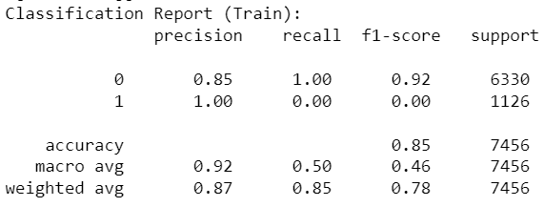
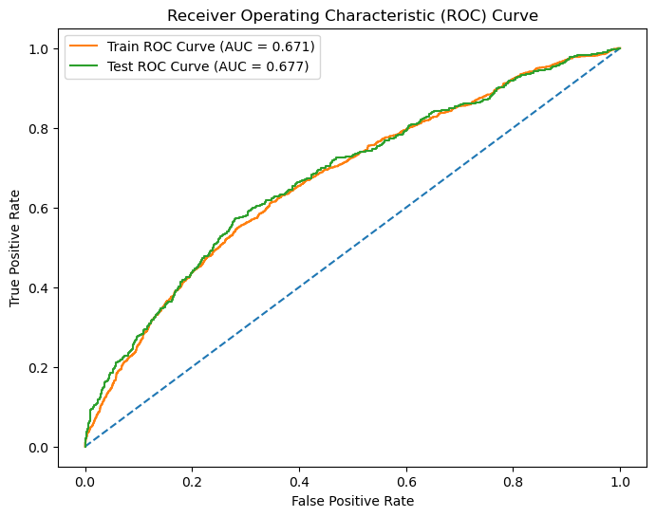
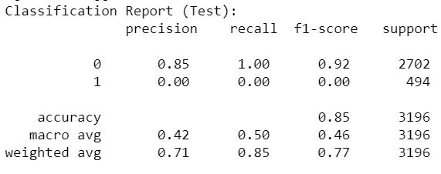
Logistic Regression Model
Mobile Users
Model Performance:
Train Accuracy: 84.92%
Test Accuracy: 84.54%

Slide 12
Interpretation
High Class Imbalance: The model performs well in predicting the majority class (not purchased) but fails to predict the minority class (purchased).
No Improvement from Tuning: Despite cross-validation, the model could not improve the prediction of the minority class.
Business Implication: The current logistic regression model is not suitable for identifying potential buyers among mobile users due to the severe imbalance in predicting classes. Consider alternative models or techniques to address class imbalance and improve overall prediction performance.

Slide 13
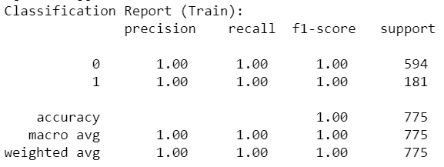
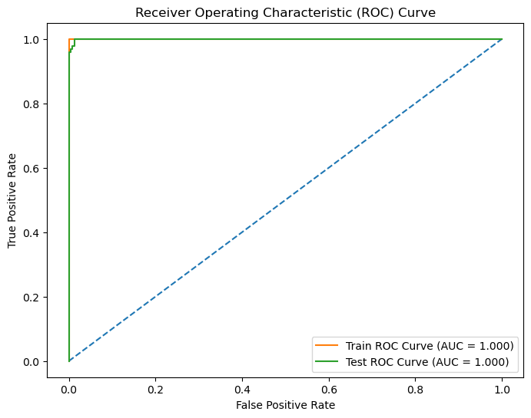
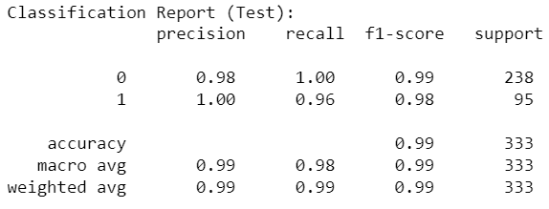
Random Forest Model
Laptop Users
Model Performance:
Train Accuracy: 100%
Test Accuracy: 98.80%

Slide 14
Interpretation
The model scores 100% accuracy on training data, indicating it fits the training data perfectly.
The model also scores very high on testing data with 98.80% accuracy, suggesting strong generalization to unseen data
Both classes (purchased and not purchased) have high precision and recall, indicating the model effectively distinguishes between the two.

Slide 15
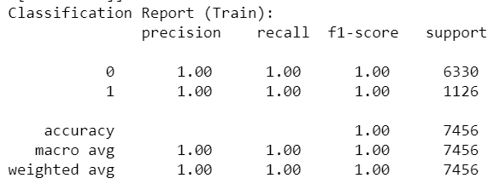
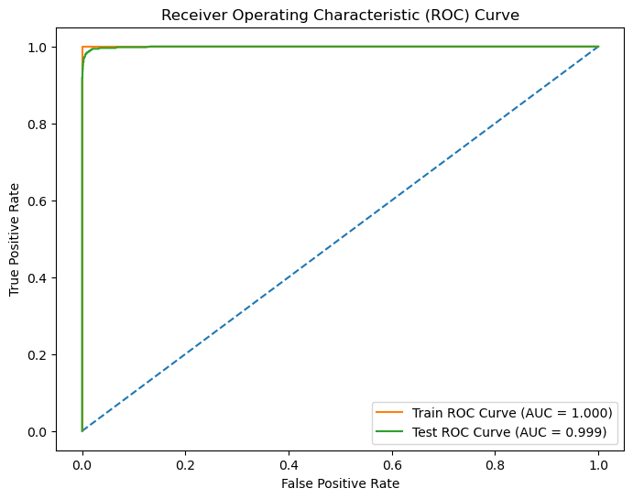
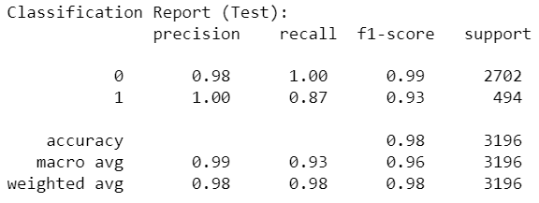
Random Forest Model
Mobile Users
Model Performance:
Train Accuracy: 100%
Test Accuracy: 97.93%

Slide 16
Interpretation
The model scores 100% accuracy on training data, indicating it fits the training data perfectly.
The model also scores very high on testing data with 97.93% accuracy, suggesting strong generalization to unseen data
Both classes (purchased and not purchased) have high precision and recall, indicating the model effectively distinguishes between the two.
The Random Forest model demonstrates excellent accuracy and performance both in training and testing phases, with high precision, recall, and AUC scores.

Slide 17
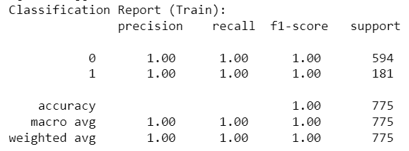

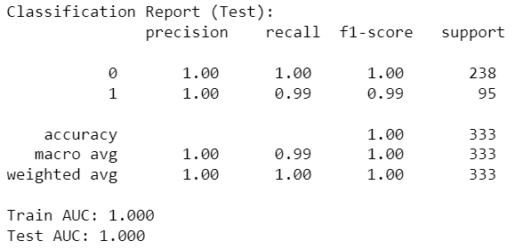
K Nearest Neighbours (KNN) Model
Laptop Users
Model Performance:
Train Accuracy: 100%
Test Accuracy: 99.70%

Slide 18
Interpretation
The model scores 100% accuracy on both training data and testing data, indicating it fits the data perfectly.
Both classes (purchased and not purchased) have high precision and recall, indicating the model effectively distinguishes between the two.
The KNN model performs exceptionally well, with perfect accuracy and AUC scores on both training and test datasets. Precision, recall, and F1-scores are also outstanding, making this model highly effective for predicting ticket purchases for laptop users.

Slide 19
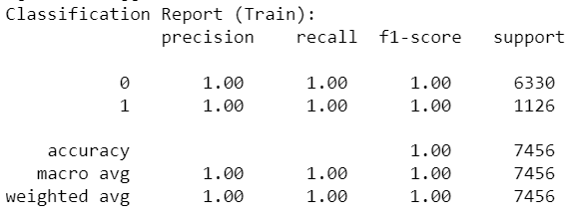
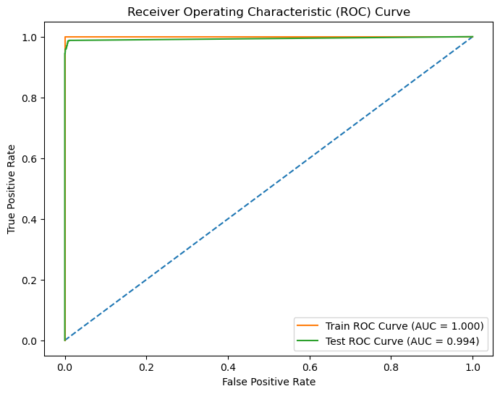
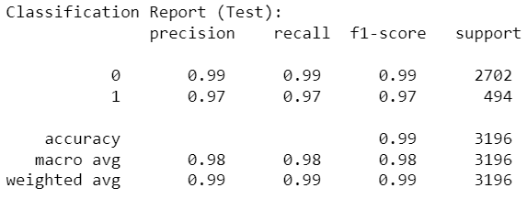
K Nearest Neighbours (KNN) Model
Mobile Users
Model Performance:
Train Accuracy: 100%
Test Accuracy: 99.12%

Slide 20
Interpretation
The model scores 100% accuracy on training data, indicating it fits the training data perfectly.
The model also scores very high on testing data with 99% accuracy, suggesting strong generalization to unseen data
Both classes (purchased and not purchased) have high precision and recall, indicating the model effectively distinguishes between the two.
The KNN model performs exceptionally well, with perfect accuracy and AUC scores on the training set and high accuracy and AUC scores on the test set. The precision, recall, and F1-scores are also very strong, demonstrating that the model is highly effective for predicting ticket purchases for mobile users.

Slide 21
Insights from Analysis
Both Random Forest and KNN models for laptop and mobile users show perfect performance on training data and near-perfect on test data, indicating significant overfitting.
Logistic Regression models have moderate performance, with an AUC of 0.797 for laptop users and 0.677 for mobile users, suggesting room for improvement.
Random Forest and KNN models achieve high precision and recall across both classes, but their perfect training performance suggests they are not generalizing well to new data.
Given the high accuracy and AUC scores of the Random Forest model for laptop users and mobile users.it should be the primary model for predicting buying behavior. Its robustness and ability to handle complex interactions make it a reliable choice.

Slide 22
Recommendations
By leveraging the model’s insights, the business can achieve higher sales and revenue growth.
Retargeting campaigns and personalized follow-up emails for users who abandon the funnel at key stages. Incentives like discounts or free trials could be offered to encourage completion.
Personalized content recommendations and targeted ads based on the most viewed pages could be used
Segmenting the audience based on model predictions and tailor marketing messages can lead to high-probability buyers

Slide 23
Thank You

